Slide 1

WINDOW FUNCTION
KRISHNA KUMAR B.K
ULLAS RAO
TEAM MEMBERS :

Slide 2
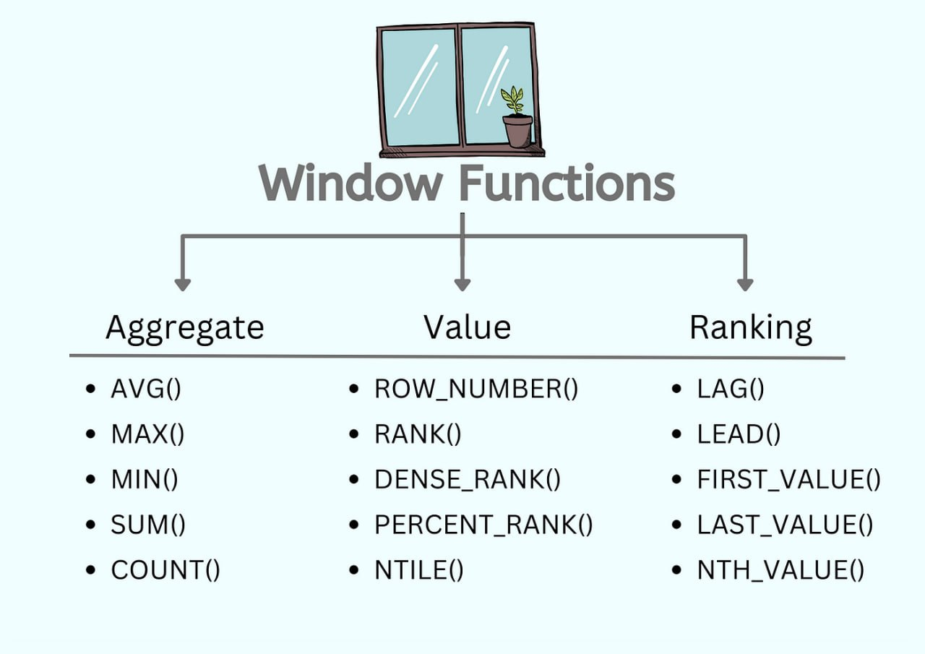
WINDOW FUNCTION IN SQL
Window functions in SQL are a powerful tool for performing calculations across a set of table rows related to the current row. window functions return a value for each row based on a specified window of rows.

Slide 3
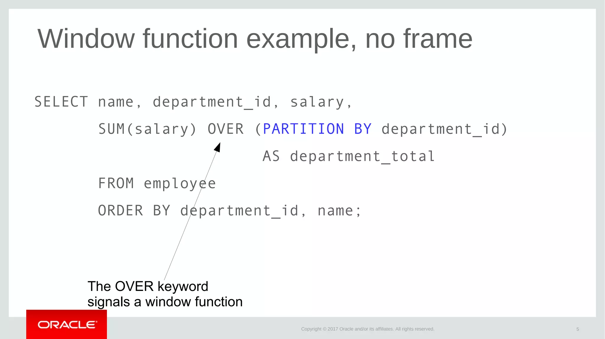
We use “over” to convert aggregate function to window function

Slide 4
AGGREGATE FUNCTION IN WINDOW FUNCTION
Combining aggregate functions with window functions in SQL allows you to perform calculations over a specified range of rows while still maintaining the detail of each individual row in your result set. Unlike regular aggregate functions which return a single value for each group, window functions provide a value for each row based on a specified window or partition of rows.
SEQUENCY OF SQL QUERY
SELECT column1,
column2,
aggregate_function(column) OVER (PARTITION BY column1 ORDER BY column2 [ROWS/RANGE BETWEEN ...]) AS window_aggregate
FROM table;

Slide 5
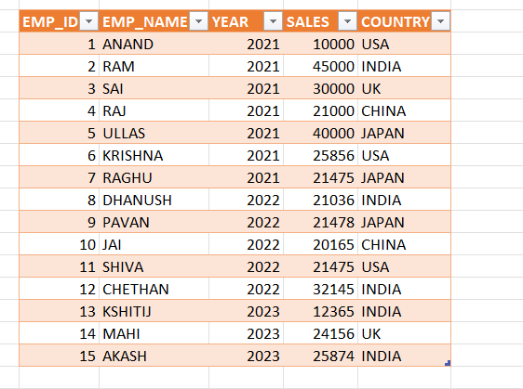
REFERENCE TABLE FOR UPCOMING CALCULATION

Slide 6
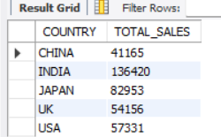
REQUIREMENTS :
1) TOTAL SALES OF EACH COUNTRY.
ANSWER
SQL QUERY :
WITH BUSINESS_OVERVIEW AS (SELECT COUNTRY,SALES,SUM(SALES) OVER(PARTITION BY COUNTRY ORDER BY COUNTRY)AS TOTAL_SALES FROM BUSINESS_OVERVIEW)
SELECT DISTINCT COUNTRY,TOTAL_SALES FROM BUSINESS_OVERVIEW;

Slide 7
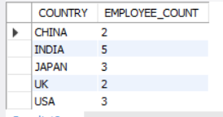
2)COUNT
REQUIREMENTS :
2) TOTAL COUNT OF EMPLOYEES IN EACH COUNTRY
SQL QUERY :
ANSWER
WITH BUSINESS_OVERVIEW AS (SELECT *,
COUNT(EMP_ID)
OVER(PARTITION BY COUNTRY ORDER BY COUNTRY)AS EMPLOYEE_COUNT FROM BUSINESS_OVERVIEW)
SELECT DISTINCT COUNTRY,EMPLOYEE_COUNT FROM BUSINESS_OVERVIEW;

Slide 8
RANKING FUNCTIOS IN WINDOW FUNCTION
Ranking functions in SQL are used to assign a unique rank or position to each row within a partition of the result set. They are commonly used for scenarios such as ordering results, determining the position of each row within a specific group, or creating rank-based reports.
RANK:RANK(): Assigns a rank to rows within a partition, with gaps in rank values for ties.
DENSE_RANK(): Similar to RANK(), but without gaps in rank values for ties.
SEQUENCY OF SQL QUERY
SELECT *,RANK() OVER (PARTITION BY partition_column ORDER BY order_column) AS rank FROM TABLE NAME;
2)SELECT *, DENSE_RANK() OVER (PARTITION BY partition_column ORDER BY order_column) AS dense_rank FROM TABLE NAME;

Slide 9
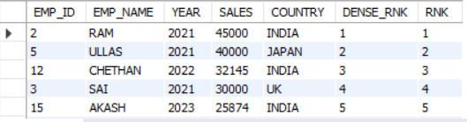
REQUIREMENTS :
3)BASED ON SALARY DISPLAY RANK AND DENSE RANK
SQL QUERY :
ANSWER
SELECT *,DENSE_RANK()OVER(ORDER BY SALES DESC) AS DENSE_RNK,
RANK() OVER (ORDER BY SALES DESC) AS RNK FROM BUSINESS_OVERVIEW;

Slide 10
ANALYTICAL FUNCTIOS IN WINDOW FUNCTION
Analytical functions (also known as window functions) are specialized SQL functions designed to perform advanced data analysis and calculations over a set of rows related to the current row
LEAD(): Accesses data from the next row in the result set.
LAG(): Accesses data from the previous row in the result set.
SEQUENCY OF SQL QUERY
SELECT *,LEAD(column_name, offset, default) OVER (PARTITION BY partition_column ORDER BY order_column) FROM TABLE NAME;
SELECT *, LAG(column_name, offset, default) OVER (PARTITION BY partition_column ORDER BY order_column) FROM TABLE NAME;

Slide 11
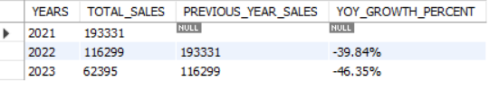
REQUIREMENT :
4)USING ANALYTICAL FUNCTION SHOW YOY GROWTH’
SQL QUERY :
ANSWER
SELECT YEAR AS YEARS,SUM(SALES) AS TOTAL_SALES,LAG(SUM(SALES))OVER (ORDER BY YEAR) AS PREVIOUS_YEAR_SALES,CONCAT( FORMAT( ( SUM(SALES)-LAG(SUM(SALES)) OVER(ORDER BY YEAR)) / LAG(SUM(SALES)) OVER (ORDER BY YEAR) * 100,2 ), '%' ) AS YOY_GROWTH_PERCENT FROM BUSINESS_OVERVIEW GROUP BY YEAR ORDER BY YEAR;

Slide 12
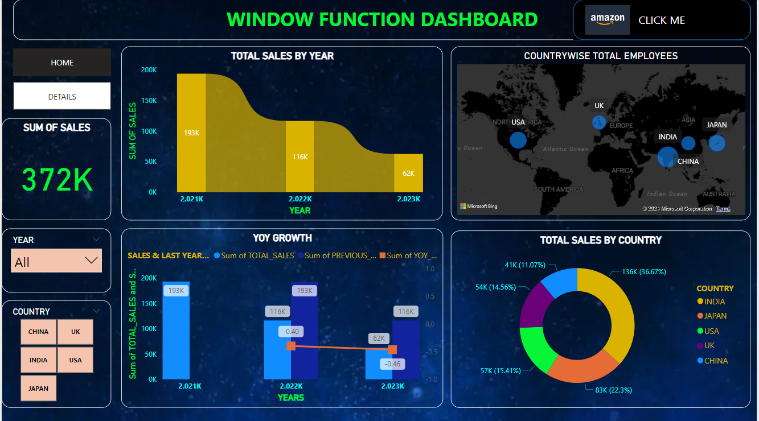
USING SQL QUERIES PREPARED DASHBOARD IN POWER-BI

Slide 13


